Slide 1
4. Write a C program to implement greedy
algorithm for job sequencing with deadlines.

Slide 2
Job sequencing with deadlines
We are given a set of n jobs.
Deadline di>=0 and a profit pi>0 are associated with each job i.
For any job profit is earned if and only if the job is completed by its deadline.
To complete a job, a job has to be processed by a machine for one unit of time irrespective of the job size( for the sake of understanding take 1 day ).
Only one machine is available for processing jobs.
A feasible solution is a subset of jobs such that each job in this subset can be completed by its deadline.
The optimal solution is a feasible solution which will maximize the total profit.
The objective is to find an order of processing of jobs which will maximize the total profit.

Slide 3
Ex:-n=4, ( p1, p2, p3, p4 )=( 100, 10, 15, 27 )
( d1, d2, d3, d4 )=( 2, 1, 2, 1 )
The maximum deadline is 2 units, hence the feasible solution set
must have <=2 jobs.
feasible processing
solution sequence value
1. (1,2) 2,1 110
2. (1,3) 1,3 or 3,1 115
3. (1,4) 4,1 127
4. (2,3) 2,3 25
5. (3,4) 4,3 42
6. (1) 1 100
7. (2) 2 10
8. (3) 3 15
9. (4) 4 27
Solution 3 is optimal.

Slide 4
Greedy Algorithm for job sequencing with deadlines
Sort p_{i} into decreasing order. After sorting p₁ ≥ p₂ ≥ p₃ ≥ … ≥ p_{n}.
Add the next job i to the solution set if i can be completed by its deadline.
3. Stop if all jobs are examined. Otherwise, go to step 2.

Slide 5
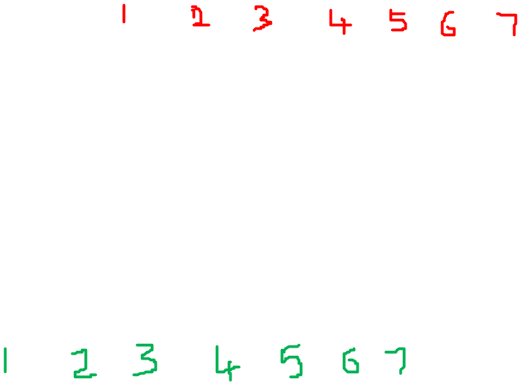
Ex:- n=7, ( e1, e2, e3, e4, e5, e6, e7) = ( 20, 15, 30, 5, 10, 2, 3) ( t1, t2, t3, t4, t5, t6, t7) = ( 4, 5, 3, 7, 6, 1, 1 )
Sort the jobs in decreasing order of profits.
After sorting…
( p1, p2, p3, p4, p5, p6, p7) = (30, 20, 15, 10, 5, 3, 2)
( d1, d2, d3, d4, d5, d6, d7) = ( 3, 4, 5, 6, 7, 1, 1 )
The optimal solution is {p6, p1, p2, p3, p4,p5} with a profit of 3 + 30 + 20 + 15 + 10 + 5 = 83.

Slide 6
Logic
Assume j is a solution array.
( p1, p2, p3, p4, p5, p6, p7) = (30, 20, 15, 10, 5, 3, 2)
( d1, d2, d3, d4, d5, d6, d7) = ( 3, 4, 5, 6, 7, 1, 1 )
Indexes
Days
Deadlines
r = k;
while( ( d[ j[r] ] > d[ i ] ) and ( d[ j[ r ] ] != r ) ) do
{ r = r-1; }
if( d[ i ] > r ) then
{
// Insert i into j[ ].
for q=k to (r+1) step -1 do j[q+1] = j[q];
j[r+1] :=i;
k:=k+1;
}
1st Day | 2nd Day | 3rd Day | 4th Day | 5th Day | 6th Day
j

Slide 7
Logic
Assume j is a solution array.
( p1, p2, p3, p4, p5, p6, p7) = (30, 20, 15, 10, 5, 3, 2)
( d1, d2, d3, d4, d5, d6, d7) = ( 3, 4, 5, 6, 7, 1, 1 )
Indexes
Days
Deadlines
r = k;
while( ( d[ j[r] ] > d[ i ] ) and ( d[ j[ r ] ] != r ) ) do
{ r = r-1; }
if( d[ i ] > r ) then
{
// Insert i into j[ ].
for q=k to (r+1) step -1 do j[q+1] = j[q];
j[r+1] :=i;
k:=k+1;
}
1st Day | 2nd Day | 3rd Day | 4th Day | 5th Day | 6th Day
j

Slide 8
Logic
Assume j is a solution array.
( p1, p2, p3, p4, p5, p6, p7) = (30, 20, 15, 10, 5, 3, 2)
( d1, d2, d3, d4, d5, d6, d7) = ( 3, 4, 5, 6, 7, 1, 1 )
Indexes
Days
Deadlines
r = k;
while( ( d[ j[r] ] > d[ i ] ) and ( d[ j[ r ] ] != r ) ) do
{ r = r-1; }
if( d[ i ] > r ) then
{
// Insert i into j[ ].
for q=k to (r+1) step -1 do j[q+1] = j[q];
j[r+1] :=i;
k:=k+1;
}
1st Day | 2nd Day | 3rd Day | 4th Day | 5th Day | 6th Day
j

Slide 9
Algorithm JS(d,j,n)
//d[i]≥1, 1 ≤ i ≤ n are the deadlines.
//The jobs are ordered such that p[1] ≥p[2] …… ≥p[n]
// j[i] is the i^{th} job in the optimal solution, 1≤ i ≤ k
{
d[0]=j[0]=0; // Initialize ( fake / dummy job )
j[1]=1; // Include job 1
k=1;

Slide 10
for i=2 to n do
{ //Consider jobs in Descending order of p[i].
// Find position for i and check feasibility of
// insertion.
r=k;
while( ( d[ j[r] ] > d[ i ] ) and ( d[ j[ r ] ] != r ) ) do
r = r-1;
if( d[ j[r] ] ≤ d[i] and d[ i ] > r )) then
{
// Insert i into j[ ].
for q=k to (r+1) step -1 do j[q+1] = j[q];
j[r+1] :=i;
k:=k+1;
}
}
return k;
}

Slide 11
Program
#include<stdio.h>
int n, p[20], d[20], j[20];
void main()
{
int i, k, total;
clrscr();
printf("Enter no of jobs\n");
scanf("%d", &n);
printf("Enter profit & dead line\n");
for( i=1; i<=n; i++)
{
scanf("%d%d", &p[i], &d[i]);
}

Slide 12
k = js( d, j, n );
printf("jobs after sorting\n");
printf(“job_no profit deadline\n");
for(i=1;i<=n;i++)
{
printf("%d %d %d\n",i,p[i],d[i]);
}
printf("Jobs processing sequence for maximum profit\n");
printf(“( Sequence is with respect to the sorted list)");
total=0;
for( i=1; i<=k; i++)
{
printf("p%d ", j[i] );
total = total + p[ j[i] ] ;
}
printf("Total profit = %d", total);
} // main end

Slide 13
int js( int d[ ], int j[ ], int n )
{ int temp,i,k, r, q;
for( i=1; i<n; i++) // Sorting jobs in decreasing order of profit
{
for( k=1; k<n; k++)
{
if( p[k] < p[k+1] )
{ temp = p[k];
p[k] = p[k+1];
p[k+1] = temp;
temp = d[k];
d[k] = d[k+1];
d[k+1] = temp;
}
}
}

Slide 14
d[0] = j[0] = 0;
j[1] = 1;
k = 1;
for( i=2; i<=n; i++)
{
r=k;
while( d[ j[r] ] > d[ i ] && d[ j[r] ] != r )
{
r = r -1;
}

Slide 15
if( d[i] > r )
{
for( q=k; q>= r +1 ; q--)
{
j[ q+1 ] = j[ q ];
}
j[ r+1 ] = i;
k++;
}
} // for end
return k;
}

Slide 16
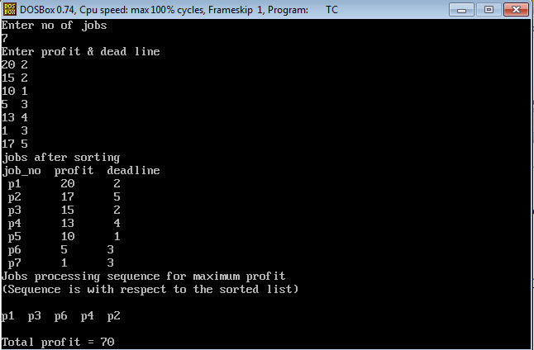
Output

